Slide 1
Office Solutions Development
Topic 5:
An Introduction to VBA and Macros
Notes:
NCC Education - Title Master

Slide 2
Scope and Coverage
This topic will cover:
  Macros - what they can be used for, how they can be developed and the role that VBA plays in their development
Notes:
NCC Education - Slide Master

Slide 3
Learning Outcomes - 1
By the end of this topic, students will be able to:
  Define what is meant by macro and VBA
  Explain that there are range of macros that are used for different purposes
  Describe the methods that can be used to develop macros
  Explain the issues of macros and security

Slide 4
Learning Outcomes - 2
By the end of this topic, students will be able to:
  Use the Visual Basic environment to create macros
  Use the Record Macro facility
  Save macros
  Edit macros

Slide 5
Terminology
  Terminology will be explained in the lecture, tutorial and laboratory session. You should take notes!
  Ask questions if you do not understand

Slide 6
What is a Macro?
  A macro is made up of a series of instructions which are recorded so that they can be played back later and this can be done by a single keystroke or command. These commands can act as a shortcut to enable repetitive tasks to be completed more efficiently and quickly.
  They can be run from a button, toolbar or menu.
  Event macros are started by an event, such as double clicking a cell, opening a workbook, or activating a worksheet.

Slide 7
Why are Macros Used?
  Macros can be used to automate and add functionality to many tasks, such as:
    formatting whole or parts of documents, worksheets,
    graphs
    re-organising data
    templates
    formatting and reports
    changing values of stored data
    error message notification
    interactive user forms/boxes, e.g. data entry

Slide 8
How are Macros Developed?
  There are two ways to develop macros:
    The easiest method is to use the Macro Recorder to record a sequence of instructions selected by a user. An application, such as Excel or Word Excel, stores information about each of the steps taken by a user as they record their commands. The macro can then be run to repeat these commands.
    Another method is for a user to write instructions using the VBA programming language.

Slide 9
What is VBA?
  VBA stands for Visual Basic for Applications and is a programming language.
  It has its own integrated development environment within Microsoft Office called the VB (Visual Basic) Editor.
  Macros can be developed using it, their instructions written in the VB Editor instead of being recorded by the Macro Recorder.
  Note that when a macro is developed using a Macro Recorder, a VBA program is written in the background and this program can be read in the VB Editor.

Slide 10
Macros and Security
  Macros are subject to security problems, such as viruses, which are frequently attached to software downloads hidden in the code of macros.
  Always ensure that your security settings are set appropriately – see http://office.microsoft.com/en-us/

Slide 11
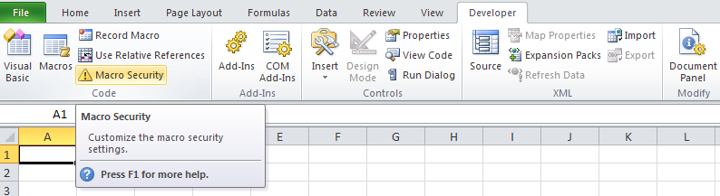
Applying Security Levels
  Apply security settings by selecting the following:
1
2

Slide 12
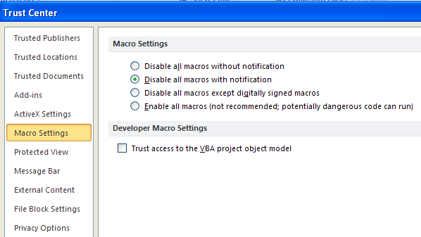
Selecting Security Levels
  The second selection is generally recommended.

Slide 13
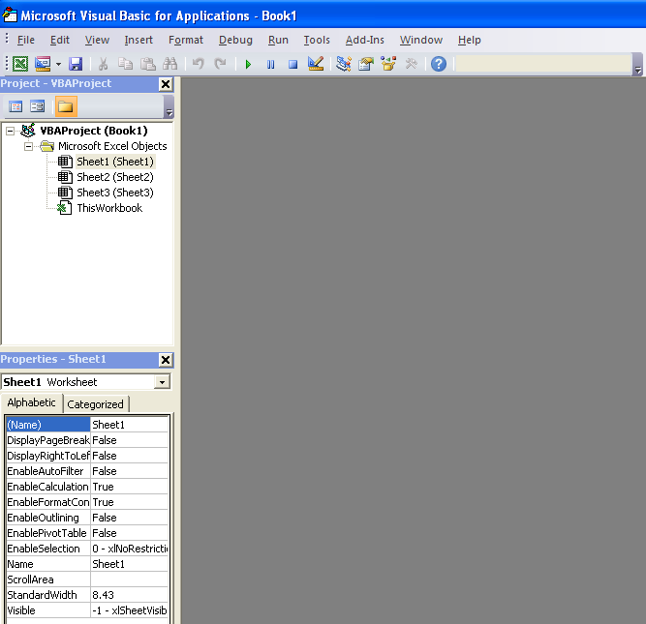
The Visual Basic Environment
  The Visual Basic Editor is
  a program within Excel and
  Word that allows you to
  communicate with Excel
  and Word by writing specific
  instructions or code.

Slide 14
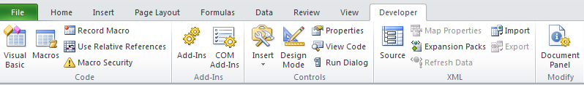
Selecting the VB Editor
This can be done either by:
- Selecting the Developer option from the Ribbon
- Selecting Visual Basic
OR
Or simply pressing the ALT key and the F11 key

Slide 15
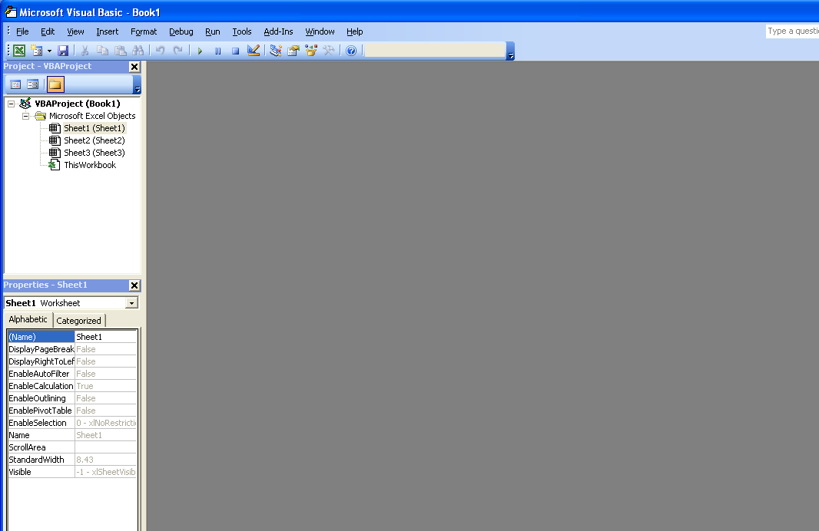
The VB Editor
  This is the VB Editor window.
  Click on the two
  to close the two windows if they are open.

Slide 16
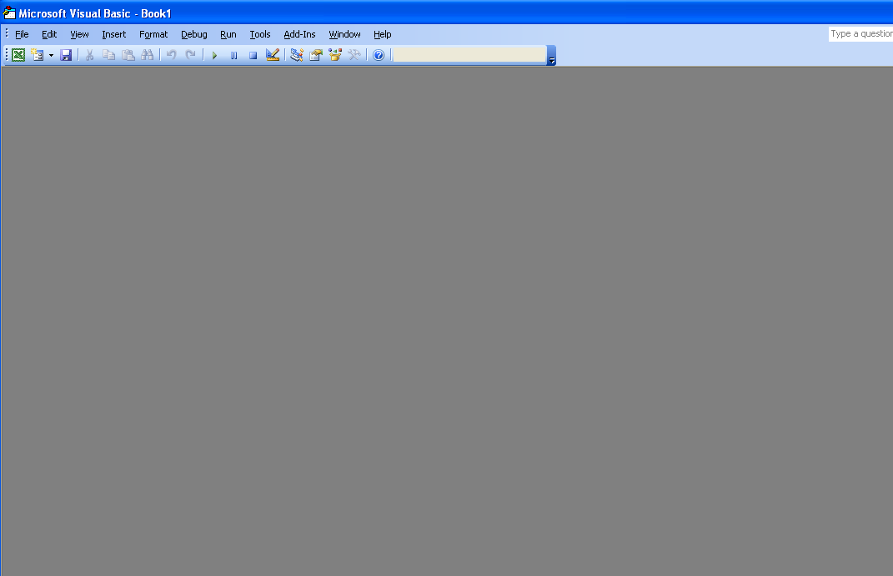
The VB Editor Screen
  The VB editor screen will now be displayed.
  To work efficiently in the VB Editor, there are three windows that should be displayed and they can be set up as follows:

Slide 17
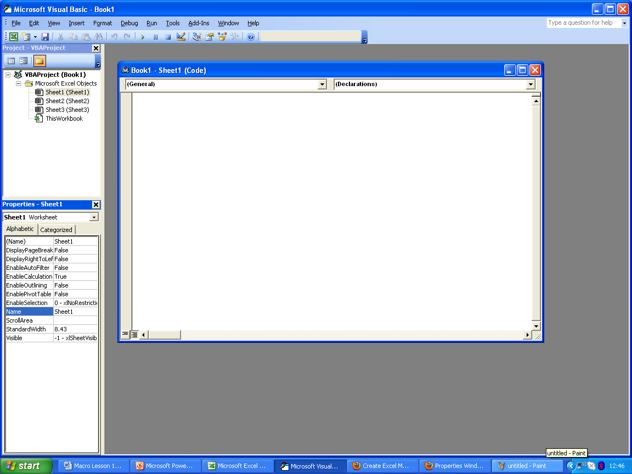
The VB Editor Windows
  - Project Window
  (Project Explorer)
  - Code Window
  - Properties Window
  We will discuss each in turn

Slide 18
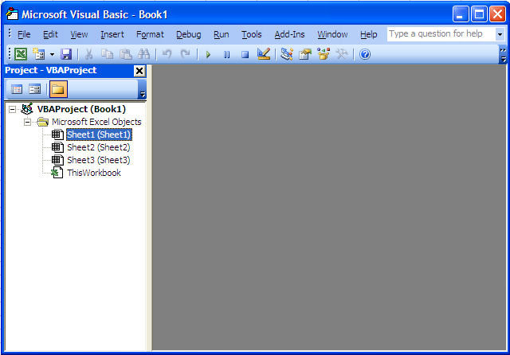
Setting up the Project Window
  Select View from the main menu bar.
  Select Project Explorer
  The Project Window will be displayed.

Slide 19
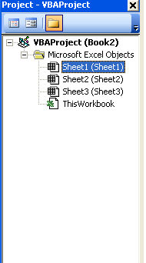
The Project Window
  This lists the projects and sheets (modules) and user forms.

Slide 20
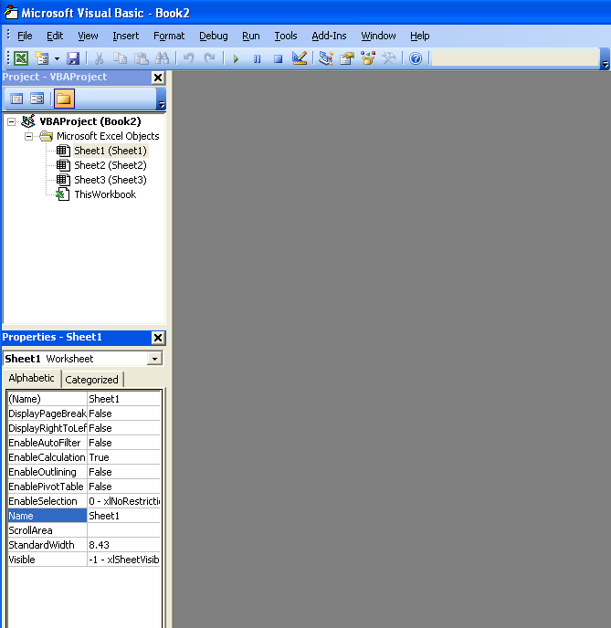
Setting up the Properties Window
  Select View from the main
  menu bar
  Select Properties Window
  The Properties Window will be displayed

Slide 21
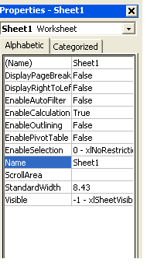
The Properties Window
  This displays the properties of the object that is selected, e.g. the worksheet or the properties of control commands, e.g. command buttons, list boxes, etc. on user forms.

Slide 22
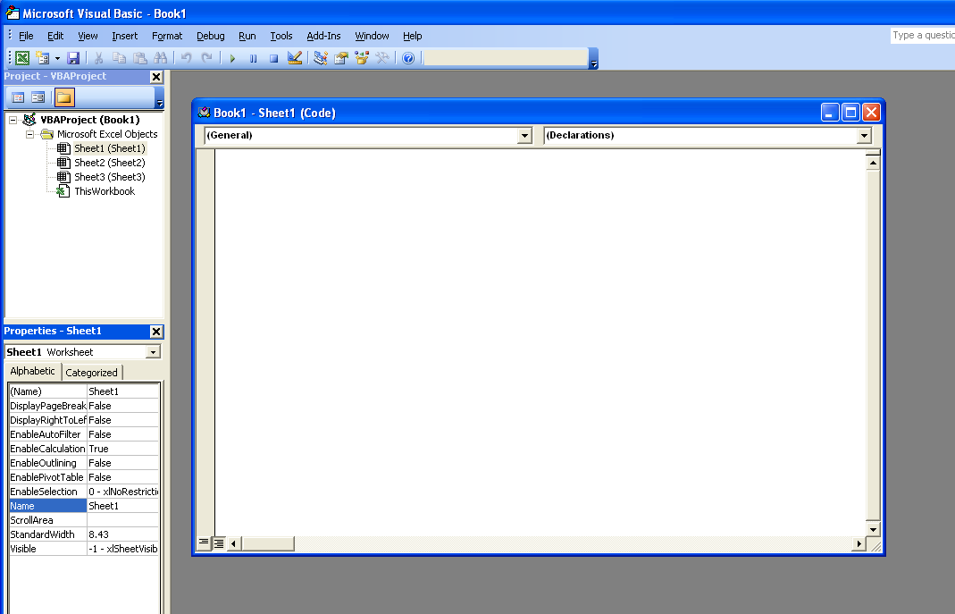
Setting up the Code Window
  Double click on the name of
  a component in the Project
  window (Sheet1, Sheet2,
  etc.)
  You can also select it via the
  View option on the menu
  and selecting the Code
  Option.
The Code Window

Slide 23
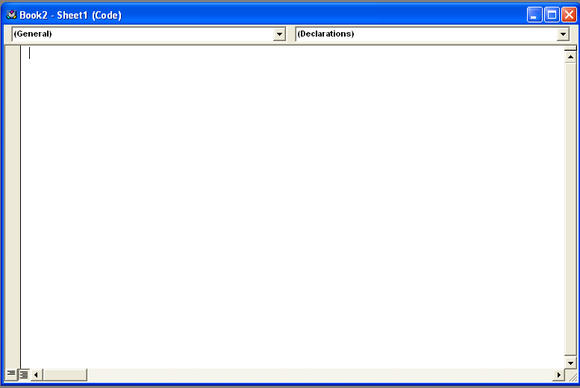
The Code Window
  Macro and VBA code is
  written and edited here.
  The font style and colour
  cannot be changed here.
  Text and figures are
  displayed in black.
  Comments are displayed in
  green, reserved words
  display in blue and error
  messages appear in red.

Slide 24
Writing a Macro
  Ensure that the Code Window for Sheet 1 is displayed.
  We will enter a simple macro that contains instructions to add together two values and display the total.
  We have to ensure that we enter all text, figures, quotation marks, full stops, brackets, equal signs and spaces accurately.

Slide 25
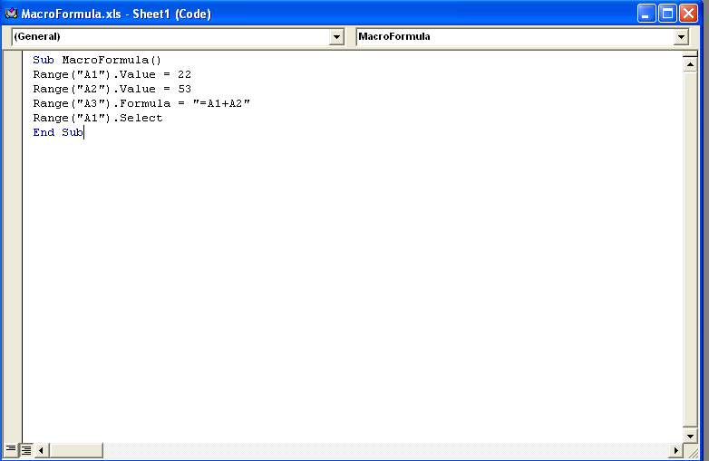
Macro Instructions
The first line presents the name of the program (user defined) always starts with Sub

Slide 26
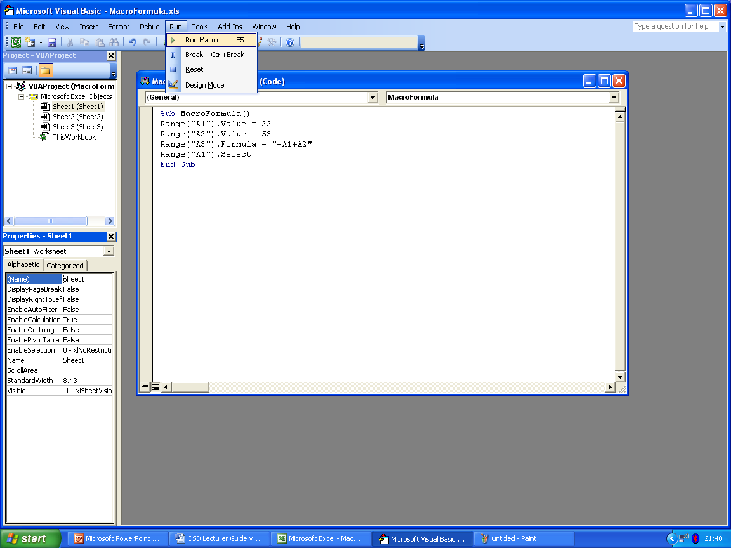
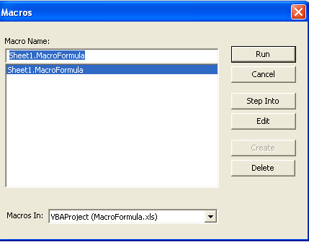
Running the Macro
  Select Run from the menu
  bar at the top of the VB
  Editor screen.
  Select Run.
  Select Run Macro.
  Run the macro.
  Press ALT and F11.

Slide 27
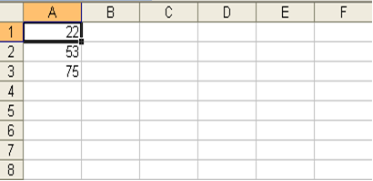
The Macro Result
  The two values have been
  added and the total
  Calculated.

Slide 28
How to Run the Macro from the Menu Bar - 1
  In Sheet 1, delete the figures in cells A1, A2 and A3.
  Select View from the Ribbon.
  Select Macros.
  In the dialogue box, select Sheet1.macroFormula.
  Select Run.

Slide 29
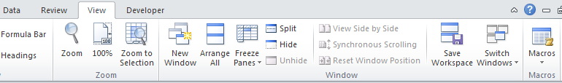
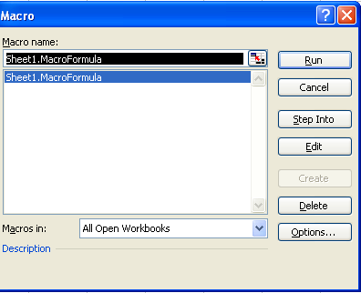
How to Run the Macro from the Menu Bar - 2
2
1
3

Slide 30
Result of Running the Macro from the Menu Bar

Slide 31
Macro Comments
  A macro comment is a piece of text in a macro which will not be executed; it is included to provide the user with information and is displayed in green.
  To let the Visual Basic Editor know that it is a comment, place an apostrophe at the start of the text.
  e.g. 'This next instruction will add the two values
  Range("A3").Formula = "=A1+A2“
  Comments become more useful if programs become more complex and it is good practice to use them.

Slide 32
Saving a Macro
  This can be done within the VB Editor
  Use relevant names
  There should be no spaces in between words.

Slide 33
Editing a Macro in the VB Editor
  Select the macro from the list in the Project Window.
  All changes can be made to an existing macro in the VB Editor Code Window.

Slide 34
References - 1
  Gonzalez, J., Meister, C., Ozgur, S., Dilworth, B., Troy, A. and Brandt, T. (2006). Office VBA Macros You Can Use Today: Over 100 Amazing Ways to Automate Word, Excel, PowerPoint, Outlook & Access. Holy Macroi Press.
  ISBN-10: 1932802061
  ISBN-13: 978-1932802061
  Jelen, B. and Syrstad. T. (2004). VBA and Macros for Microsoft Excel. Pearson QUE.
  ISBN-10: 0789731290
  ISBN-13: 978-0789731296

Slide 35
References - 2
  Krieger, S. (2011). Macros Demystified: what they are and why to use them. [Available Online] http://office.microsoft.com/en-us/help/macros-demystified-what-they-are-and-why-to-use-them-HA010007210.aspx
  McFedries, P. (2007). VBA for the 2007 Microsoft Office System. Pearson QUE.
  ISBN-10: 0789736675
  ISBN-13: 978-0789736673
  Walkenbach J. (2004). Excel VBA Programming for Dummies. Wiley Publishing, Inc.
  ISBN: 5000024675

Slide 36
Topic 5 – An Introduction to VBA and Macros
Any Questions?
Notes:
NCC Education - End Slide Master

